Slide 1
Modeling Lifestyle Factors and Smoking Mortality in the U.S. Using Big Data:
An Analysis of the National Longitudinal Mortality Study, Tobacco-Use Cohort
Naman Dhariwal, Nicole Jerome, Indhira Vadivel
Notes:
Nicole

Slide 2



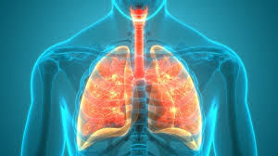
Background
Cardiovascular Disease
Cigarette smoking remains one of the leading preventable causes of death worldwide.
Cancer
Respiratory
Illness
Notes:
Nicole
driving excess mortality from cardiovascular disease, cancer, and respiratory illnesses

Slide 3


Background Literature
Study: In 2024, researchers used machine learning to model the effects of lifestyle, environmental, and socioeconomic factors, along with tobacco use attributes on mental health.
Findings: Addiction attributes like tobacco and alcohol use were highly informative features in the model.
Limitations: The study used a small cohort of participants in Barcelona. Mortality prediction was not assessed.
Notes:
Nicole

Slide 4
The National Longitudinal Mortality Study (NLMS) Tobacco-Use Dataset:
500,000 participants in the United States
5 years of follow up (1-1827 days) with mortality outcomes
Real World Comprehensive data on smoking behaviors, demographics, socioeconomic status, and lifestyle factors(43 variables)
Variable Category: | Examples:
Demographic | Age, Sex, Race, Marital Status
Socioeconomic | Education, Adjusted Income, Poverty Ratio, Employment Status
Smoking-Related | Duration, Smoking Frequency, Cigarettes/Day
Mortality Outcome | Death Indicator, Days to Death, Cause of Death
Notes:
Nicole

Slide 5
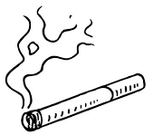

Our Objective and Research Questions:
Objective:
Predict mortality risk among smokers while accounting
for demographic and socioeconomic characteristics.
Research Questions:
Which demographic or socioeconomic factors (income, education, race, etc.) modify the smoking–mortality association?
Can we build accurate and interpretable models to predict mortality risk among smokers?
How does time since smoking initiation relate to 5-year mortality risk?
What are the most influential factors in mortality prediction?
Notes:
Nicole

Slide 6
General Project Workflow:
Data Acquisition and Preprocessing
Exploratory Data Analysis
Feature Engineering
Model Development, Selection, and Evaluation
Risk Profiling and Interpretation
Reproducibility and Documentation
Notes:
Indhira

Slide 7


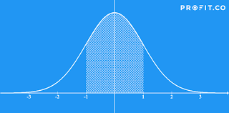
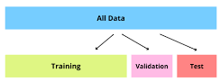
Data Acquisition and Preprocessing
NIH-Biologic Specimen and Data Repository Information Coordinating Center
https://biolincc.nhlbi.nih.gov/requests/public-use-dataset-request/17175/
Import NLMS Tobacco-Use data into a distributed environment using R (data.table, arrow) and Python (PySpark, Dask).
Perform data cleaning: find missing values, recode categorical variables, and derive key variables (e.g., smoking duration in days).
Partition data into training, validation, and test sets using stratified sampling to preserve mortality proportions.
Notes:
Indhira

Slide 8
Exploratory Data Analysis
EDA | Big-Data Technique | Tool
Large-scale summary stats | Columnar scan, lazy evaluation, distributed summarise | Arrow + dplyr
Univariate relationships | Distributed group-by | Arrow
Multivariable GLMs | Chunk-wise model fitting | bigglm
Scalable plotting & Visualizing risk patterns | Sampling via Arrow; aggregation before plotting | Arrow + ggplot2
Quantiles | Approximate quantiles (fast, streaming) | Arrow
Notes:
Indhira

Slide 9

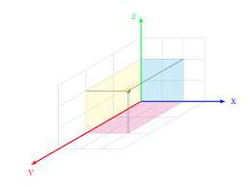
Feature Engineering
Encode demographic and socioeconomic variables using one-hot or label encoding.
Transforming data by standardization techniques like StandardScaler
Derive crucial lifestyle features (marital status, employment type, income categories) for model inclusion.
Imputing missing data but statically significant values
Notes:
Naman

Slide 10


Model Development, Selection, and Evaluation
Train baseline statistical models: Logistic Regression or Random Forest as baselines.
Implement scalable machine learning models using distributed frameworks:
  Gradient boosting (XGBoost)
  Deep Neural Networks
  Regularized models (L1/L2)
Compare classical survival analysis with ML-based mortality prediction.
Notes:
Naman

Slide 11
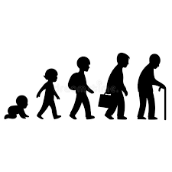


Risk Profiling and Interpretation
Evaluate models and substantiate good fit.
Generate mortality risk scores stratified by smoking duration, sex, age, and socioeconomic status.
Identify feature importance and crucial predictors.
Notes:
Naman

Slide 12


Reproducibility and Documentation
Maintain version-controlled scripts using Git/GitHub.
Provide reproducible well-documented code notebooks and ready-to-use model, demonstrating the full pipeline.
Notes:
Naman

Slide 13

Current Progress:
Data Acquisition and Preprocessing
Exploratory Data Analysis
Feature Engineering
Model Development, Selection, and Evaluation
Risk Profiling and Interpretation
Reproducibility and Documentation
Notes:
Indhira

Slide 14

Thanks for Listening!

